Slide 1
Design Laboratory
EE-305
Deep Learning models for Improving Performance of
OOK Modulation Over FSO Turbulent Channels
Supervisor: Dr. Sumanta Gupta
Presenters:
Akshat Porwal(1901EE09),
Omkar Deshpande(1901EE43),
Shubham Diwakar(1901EE58)

Slide 2
Objective
Due to its low power consumption, high speed and high capacity, Free Space Optical (FSO) communication technology is recently gaining attention.
The only hindrance in the mass use of this technology is it struggles in turbulent atmosphere. Turbulent atmosphere causes scintillation in the signal.
In this presentation we compare 3 Deep Learning models for improving performance of OOK modulation over FSO channels. The 3 models are based on Artificial Neural Networks (ANN), Fully Connected Layers (FC) and Fully Convolutional Neural Networks (FCNN) respectively.
Here, the comparison among the 3 models is based on BER vs SNR Plot and Accuracy/Loss vs Epochs.

Slide 3
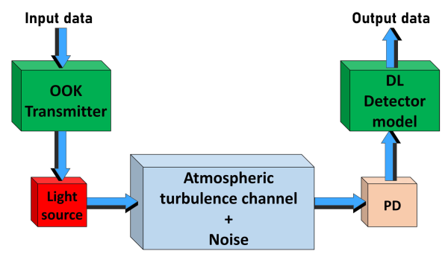
FSO Communication System

Slide 4
Understanding the Input Dataset
3 Different values of Turbulences are taken
Corresponding to High(10⁻¹³), Moderate(10⁻¹⁴)
and Low(10⁻¹⁵) turbulences.
26 SNR Values from 5 to 30 are taken
SNR={5,6,7…….,30}
For every turbulence value, for every SNR value, we store 500 signals of 512 bits.
Now there is a wide range of values in the signal and hence we need to normalize/scale it so that the output is correctly predicted.
Now we save the correct signals for training and simulate transmission through turbulence.

Slide 5
Scaling of Input Signal:-
Let the value of current signal value is cur.
Replace the value of each bit of a particular Input Signal by:
Here mean denotes mean of values of Input Signal
max denotes maximum of values of Input Signal
min denotes minimum of values of Input Signal.
We normalise the data such that the generated signal values are between [-1,1], using the following algorithm.

Slide 6
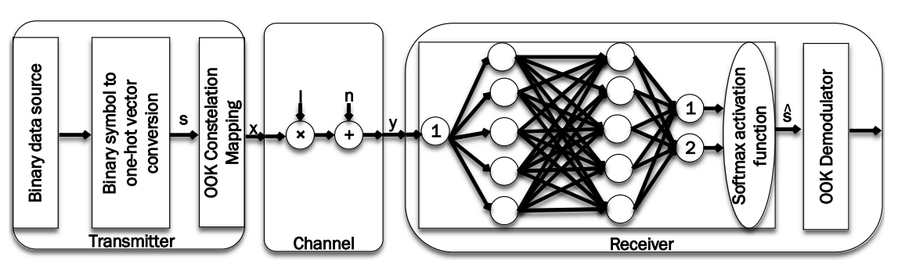
Artificial Neural Network based model

Slide 7
As seen, here the input (received modulated wave) directly enters into a DNN and detects it, and does not need any information about SNR, or any other information for training the DNN.
The aim of the training is to reduce the difference between the DNN
output (the detected symbol) and the target (the transmitted
symbol).
For this model we have calculated BER vs SNR Plot, also Accuracy vs Epochs plot.

Slide 8
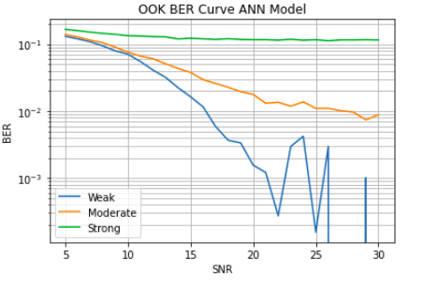
BER vs SNR Plot for different turbulences:-
Value of Cn^2 for Weak turbulence is :10^(-15)
Value of Cn^2 for Moderate turbulence is :10^(-14)
Value of Cn^2 for Strong turbulence is :10^(-13)

Slide 9
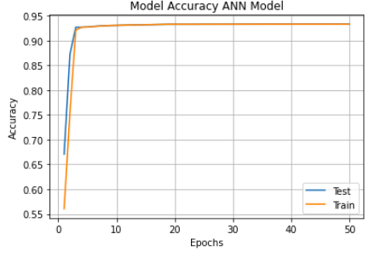
The model achieves an accuracy of 93.29%

Slide 10
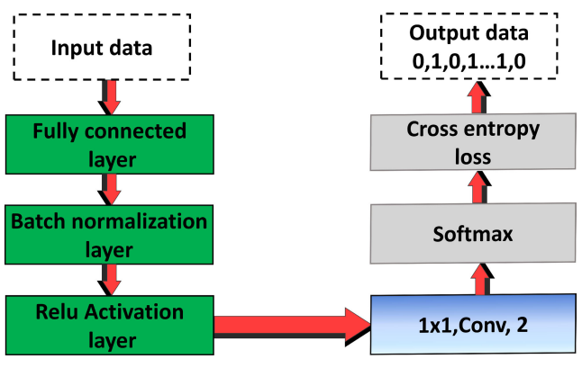
Fully Connected Network based model

Slide 11

In our DL models, we used a Relu activation function: fRelu(xi) = max(0, xi) after each internal layer and the last layer is a convolutional layer with two filters of size 1 × 1.
This layer is followed by a softmax activation layer:
that converts the values of the output data from this layer to probabilities from values 0 to 1.
At the end we use the cross entropy function to determine the loss, that is the difference in the probabilities, the original ones and the ones predicted by our model.

Slide 12
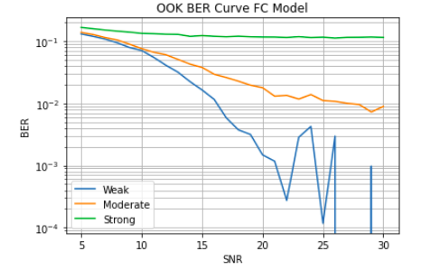

Slide 13
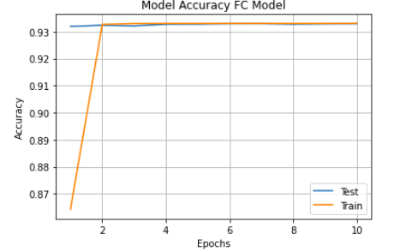
More accuracy than ANN model is achieved
less number of epochs are used than the ANN Model.

Slide 14
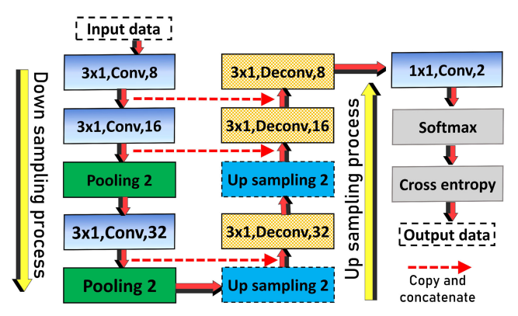
Fully Convolutional Neural Network based model

Slide 15
In this model we use FCNNs with concatenation of memory from previous layers.
This model includes two processes, namely down sampling and up sampling.The down sampling process is used to extract the data.In the up sampling process, we used the inverse process that we used before in the down sampling process.
After the up-sampling process, we used convolutional layers of two classes followed by a softmax activation function.
Then, the cross-entropy loss function is used to calculate the minimum loss between the input and the detected data bits.
The output of this model is a vector of data bits.

Slide 16
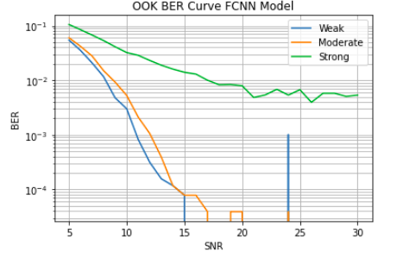
BER vs SNR Plot for different turbulences:-
Value of Cn^2 for Weak turbulence is :10^(-15)
Value of Cn^2 for Moderate turbulence is :10^(-14)
Value of Cn^2 for Strong turbulence is :10^(-13)

Slide 17
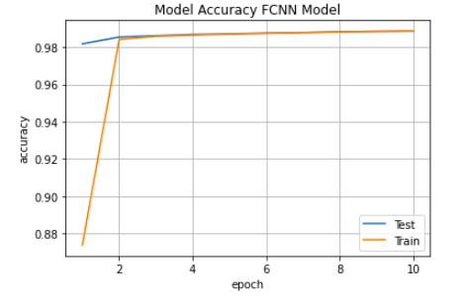
In FCNN highest accuracy is achieved of nearly 98% with the use of only 10 Epochs.

Slide 18
Comparison of Results of 3 Models:-
For each turbulence BER performance against the normalized SNR for conventional detector with Fixed Threshold, ANN Model , DNN FC Model, and DNN-FCNN model is plotted.

Slide 19
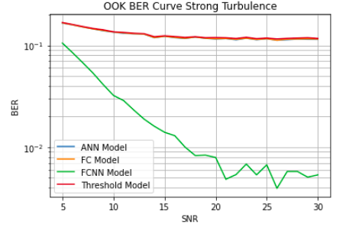

Slide 20
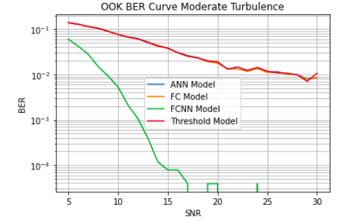

Slide 21
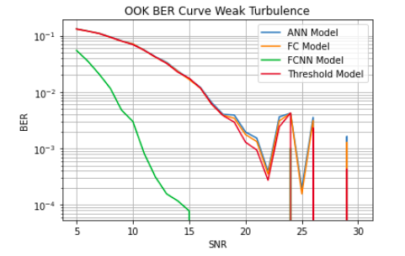

Slide 22
Conclusion
We studied variation of bit-error-rate(BER) over signal-noise-ratio(SNR) and three different atmospheric turbulences.
The results clearly depict the high performance of FCNN model over all other neural network architectures. .
For a particular model its performance is best in weak turbulence followed by moderate turbulence followed by high turbulence conditions.
For a particular turbulence results are best for FCNN based model followed by FC model followed by ANN model followed by Fixed Threshold model.
In addition, this structure is robust to any changes in the structure of the system, and channel, and by a simple training procedure could get adapted to any structural changes

Slide 23
Future Work:-
The FSO fading due to atmospheric turbulence has a good scope of improvement in terms of deep learning based models.
Different combinations of CNN layers can be considered with different sizes of kernels.
Our work limits to OOK modulation while we can check the performance of deep learning models for higher modulation schemes as well such as PAM4 and QPSK and QAM.

Slide 24
References
[ 1 ] Darwesh, L., Kopeika, N.S.: Deep learning for improving performance of OOK modulation over FSO turbulent channels. IEEE Access. 8, 155275– 155284 (2020).
[ 2 ] Amirabadi, M.A., Kahaei, M.H., Nezamalhosseini, S.A.: Deep learning based detection technique for FSO communication systems. Phys. Commun. 43, 101229 (2020).

Slide 25
Source Code:
Model1- https://colab.research.google.com/drive/1wTexzvY-j_xTSORt-bvYlop39-3Q-pIl#scrollTo=HL0Z54bIF4WM
Model2- https://colab.research.google.com/drive/1FCtZJCsVVKRSmImGa4duuWNCu8uwXGi8#scrollTo=sZe9lV79Zyxb
Model3- https://colab.research.google.com/drive/1sckNxAQ_fW8cY4CIh8fjoyWv7R2WVlhn#scrollTo=GbY4oG5mkduB

Slide 26


